Slide 1



2nd solution of HMS - Harmful Brain Activity Classification
coolz
Notes:
1. Hello, everyone.
2. First of all, thanks kaggle and the host for providing this opportunity. And It’s very hornor to give a presentation about my solution.

Slide 2
Agenda
Notes:
let’s see what we will talk aout in the next?

Slide 3
Agenda
Background
Insight
Model
Ensemble
Training methods
Q&A
Notes:
There will be 6 parts, in total, as listed in this slide.

Slide 4
Background
Notes:
I am going to give a self introduction in this part.

Slide 5
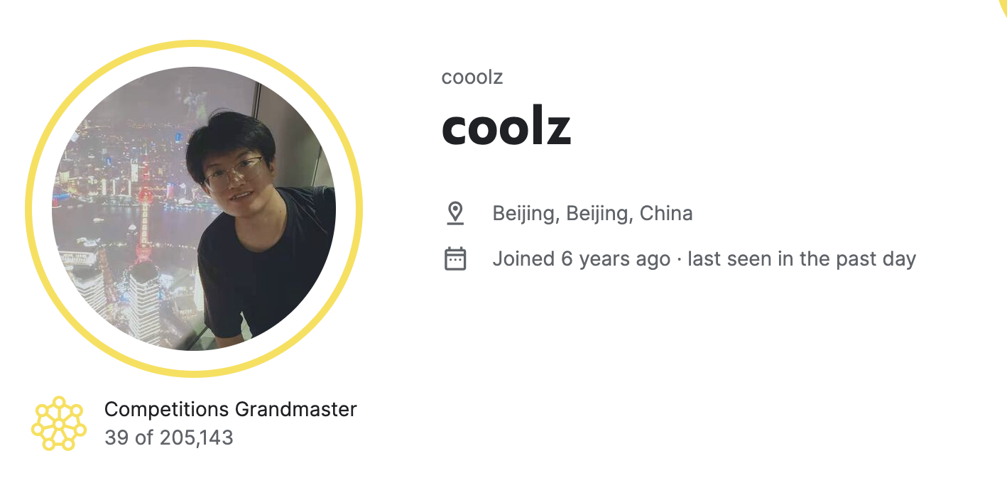
Background
Bachelor's Degree in Applied Physics
Master's Degree in Optical Engineering
Computer Vision Engineer
Notes:
1. I have a bachelor’s degree in applied physics, and master with OE.
2. My research subject during the master time, is image system .
3. And, i am a computer vision enginier in a company in CHina.
4. And last, i become a grandmaster after the birclef 2024.

Slide 6
Insight
Notes:
Then, i will talk about how i get the insights in this game.

Slide 7
Insight
Feeding a bsx4xHxW input to the 2D-CNN produce worse result than the one-image method. I start to think why?
《Position, Padding and Predictions: A Deeper Look at Position Information in CNNs》
https://arxiv.org/pdf/2101.12322.pdf
Notes:
1.In the disccusion forum and public notebook, in the early time.
2.Methods are more about concat spectrums into one image. And the performance is better than multiple channels spectrum.
3. Then i start to think why? Later comes to an clusion that is channel position is important.
4. Obviously, different channel means different position on the brain. And the label is position senstive, for example, generalized periodic discharges (GPD), lateralized periodic discharges (LPD).

Slide 8
Model
Notes:
Then comes to this part. How i design the MODEL.

Slide 9
Model
Raw signal model, 2d
Spectrum based model, 3d and one-image
Hybrid
Notes:
1. Three type of models were developped.
2. Including Raw signal model, spetrum based model, and a mixtre of these two part.

Slide 10
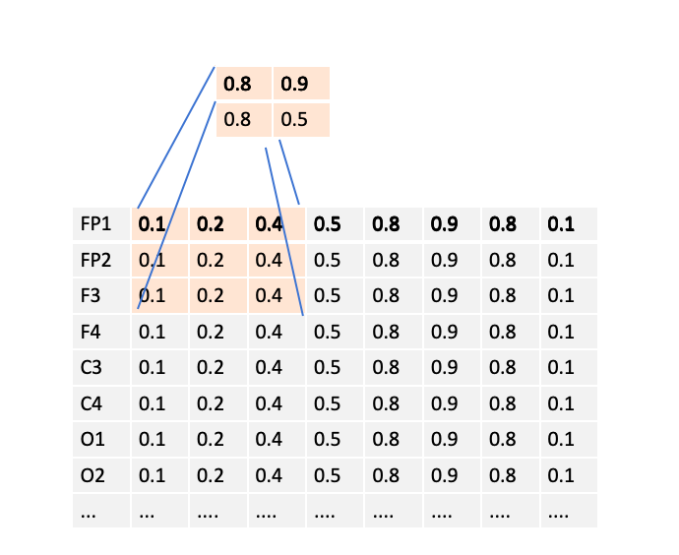
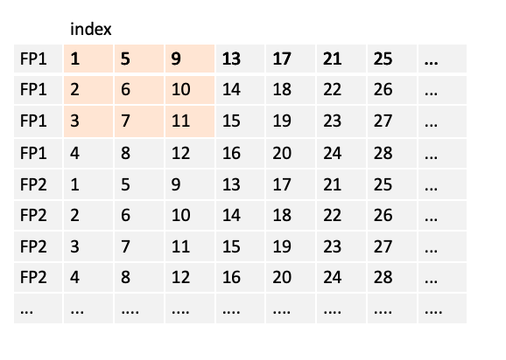
Model
RAW eeg model
With efficinetnetb5,
public lb 0.230
private lb 0.282
bsx16x10000
bsx(160)x1000
Notes:
1. As shown in the left figure, each row is a eeg data sequence.
2. By concating the data along the channel axis, it will produce an image like 2-d array. Then it can be feeded into an vision model.
3. However the sequence is too long, it’s difficult for a vision model to cover such a big size in x direction. Then a slice and reshape operators are needed. After the packing, than we get an 160x1000 image.
4 . Here i do some experiments about the reshape params, and 160x1000 is the best there.
5. And with this model, get public lb 0.23, and private lb 0.282.

Slide 11
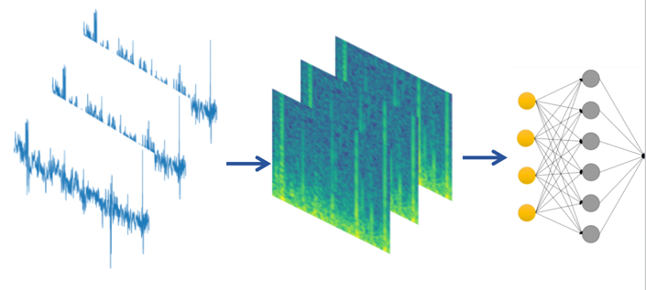
Model
3d spectrum model
2d cnn:
NxCxHxW
3d cnn: NxCxTxHxW
Notes:
1.Then , the spectrum model.
2. Different with the method is in the public notebook, I use a 3d vision model, which can capture the sequence feature and the channel relationship better.
3. By applying stft transform, the waveform produce a 16 channels sprectrums, then unsquezee the C dim, and repeat 3. we get a plain input for 3d vision model.

Slide 12
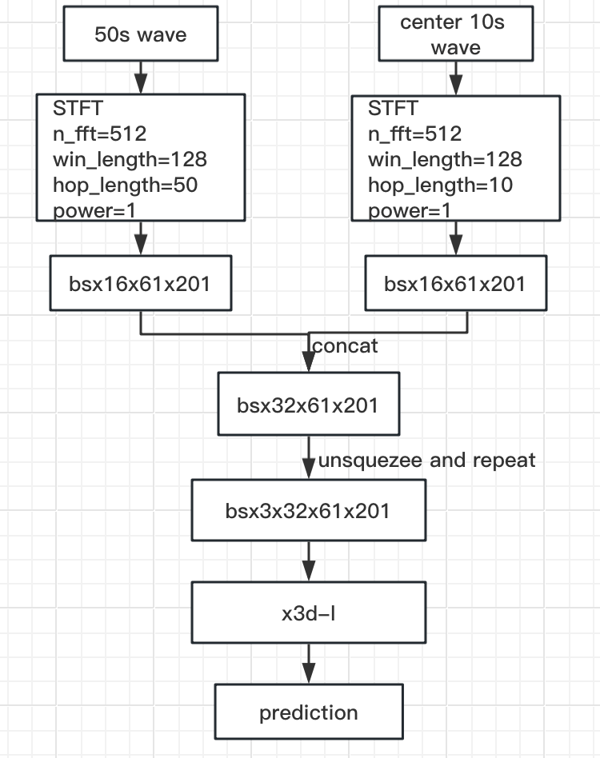
Model
3d spectrum model
X3d-l cv 0.21+
public lb 0.25
private lb 0.29.
Notes:
There is the detail about the model.
1. I use two inputs, A 50s wave and a center 10s wave, but with different stride when doing the stft.
2. after the stft, concat them, then feeded into the x3d vision model.
3. this model get public 0.25 ,private 0.29.

Slide 13
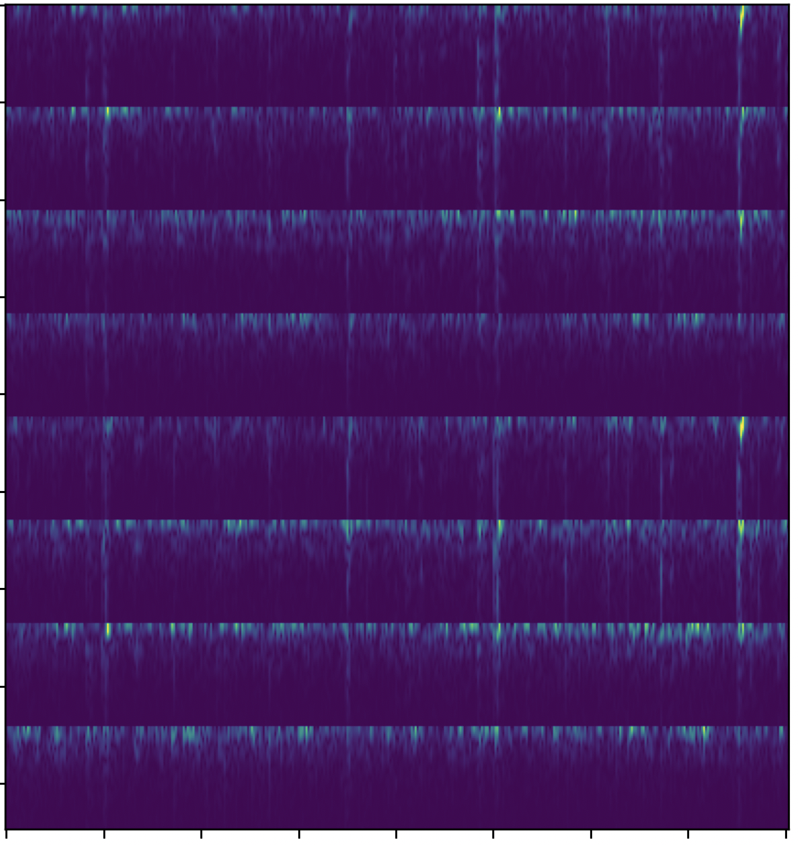
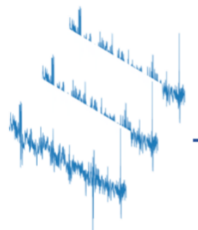
Model
oneimage spectrum model
fp1 fp2
3 4
...
efficientnetb5
efficientnetb5,
public lb 0.26
private lb 0.30.
combine these two spectrum model, get 0.28 private lb.
[1x3x424x402]
Notes:
1. I also use oneimage method to add diversity, like in the public notebook.
2. It scores public 0.26, private 0.30.
3. combine these two spectrm model ,get 0.28 private lb.

Slide 14
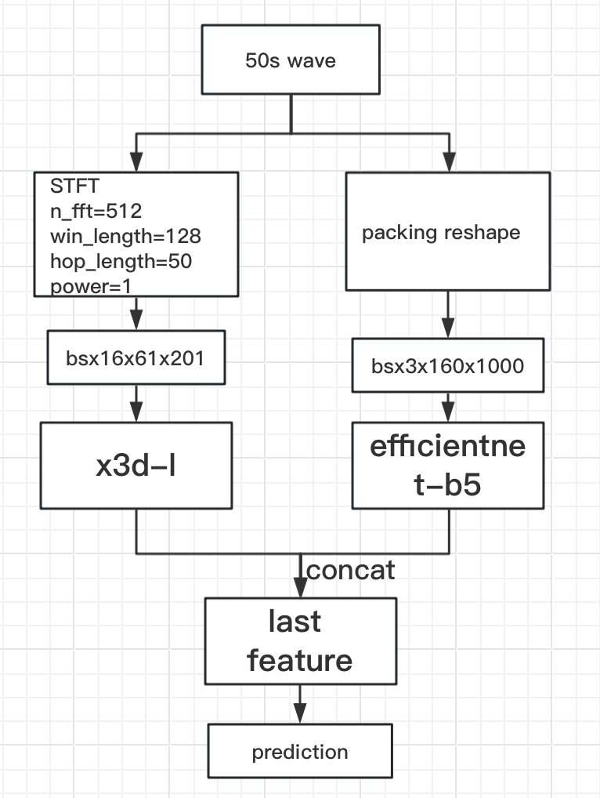
Model
hybrid model
public lb 0.232
private lb 0.285
Notes:
1. A mixsure of the raw signal and the spectrum is constructed.
2. Basicly, it’s the same with the previous model, left branch is waves->stft->x3d, right branch is waves->packed reshap->effnetb5. then concat the feature do the predict.
3. It scores public 0.232, private 0.285, I expected the model work the best, but not that good as the raw signal model. Maybe more tunning is needed.

Slide 15
Ensemble
Notes:
Then coms to ensemble.

Slide 16
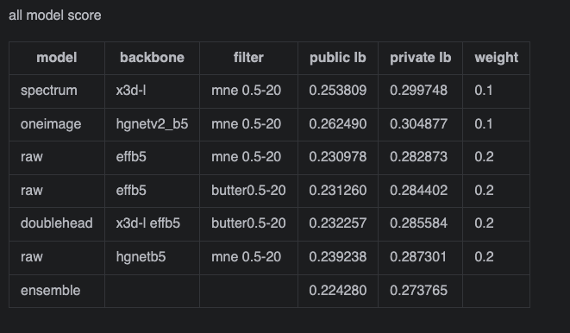
Ensemble
Notes:
1. There are 6 models in the final ensemble, 3 raw signal models, 2 spectrum models, and a mix model.
2. Different backbones are used, including hgnetb5,effnetb5,x3d-l.
3. I didn‘t tune too much about the ensemble weights.

Slide 17
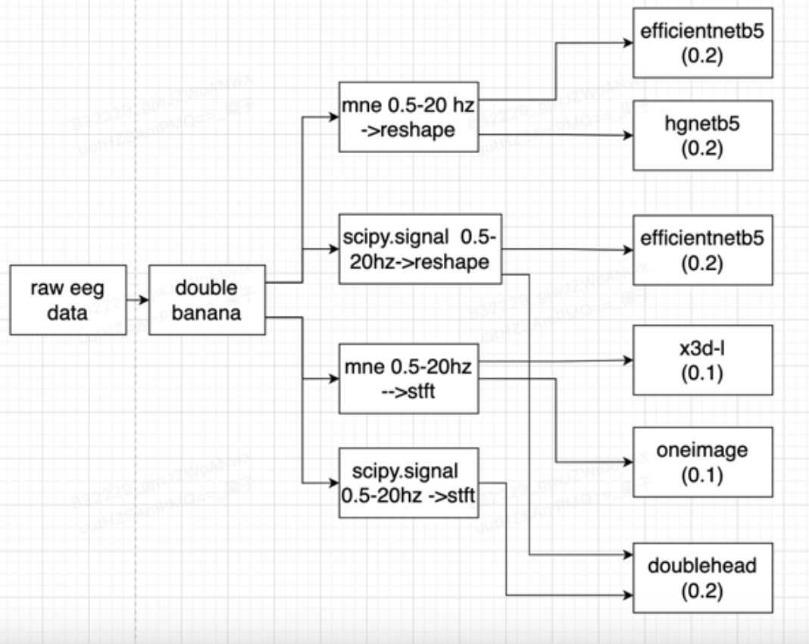
Ensemble

Slide 18
Training Methods
Notes:
Then we will talk about the trainning procedure.

Slide 19
Training Methods
Data were grouped by eeg_id
Random sample a eeg_label_offset for each eeg_id when trainning.
offset = int((offset_min + offset_max) // 2) when validation, and vote= np.mean(sum(votes))
target is averaged across subsamples in one eeg_id
data
eeg_id | eeg_offset_list | target | votes
568657 | [0.0, 6.0, 12.0, 16.0] | 0.0,0.0,0.25,0.0,0.17,0.58 | [8, 12, 8, 8]
Kaggle Winner Presentation Template
Notes:
The data were reconstructed.
1. data were grouped by eeg_id.
2. When trainning, for each iter, a eeg_label_offset were random sampled, also a vote numer.
3. When validation, we use the middle, offset=int((offset_min + offset_max) // 2), vote= np.mean(sum(votes))
4. and the target is averaged across subsamples in one eeg_id

Slide 20
Training Methods
preprocess
Double banana montage, eeg as 16x10000
Clip by +-1024
Filter with 0.5-20hz, mne and scipy.signal
Kaggle Winner Presentation Template

Slide 21
Training Methods
trainning
Stage1, 15 epochs, with loss weight voters_num/20, Adamw lr=0.001, cos scheduel, warmup 800 iters.
Stage2, 5 epoch, loss weight=1for voters_num>=6 ,weight=0 for num<6, Adamw lr=0.0001, cos scheduel
Augmentation, mirror eeg, flip between left brain data and right brain data.
10 folds, then move 1000 samples from val to train, left 709 samples in val set. And use vote_num>=6 to do validation.
Kaggle Winner Presentation Template
Notes:
I use two stage trainning as most people does.
In stage 1,
In stage 2,

Slide 22
Training Methods
Things tried but not work
other type of lead
raw signal without any process
different filter, for example, 0-70hz, 0.5-40hz
random scale in amplitude.
random droup some channel
Kaggle Winner Presentation Template

Slide 23
Question and Answer

